Slide 1


Kareem Dana, Jeffry Babb, Musa Jafar
West Texas A&M University
Department of Computer Information Systems
https://github.com/wtamu-cisresearch/isecon
Notes:
Hi. My name is Kareem Dana. I am a researcher and instructor at WTAMU in the department of computer information systems.
For the next 45 minutes or so, We’re going to give an introduction to HTML5 – what it is, how it works, what you can do with it in the classroom, and show some fun examples of what its capable of.
We will also have a few hands on demos of HTML 5 with code available, so you can follow along. If you’d like to do that. Here is the code, get your laptops out and open up your favorite text editor.
[IMPROVE] Upload code online. Show Link

Slide 2
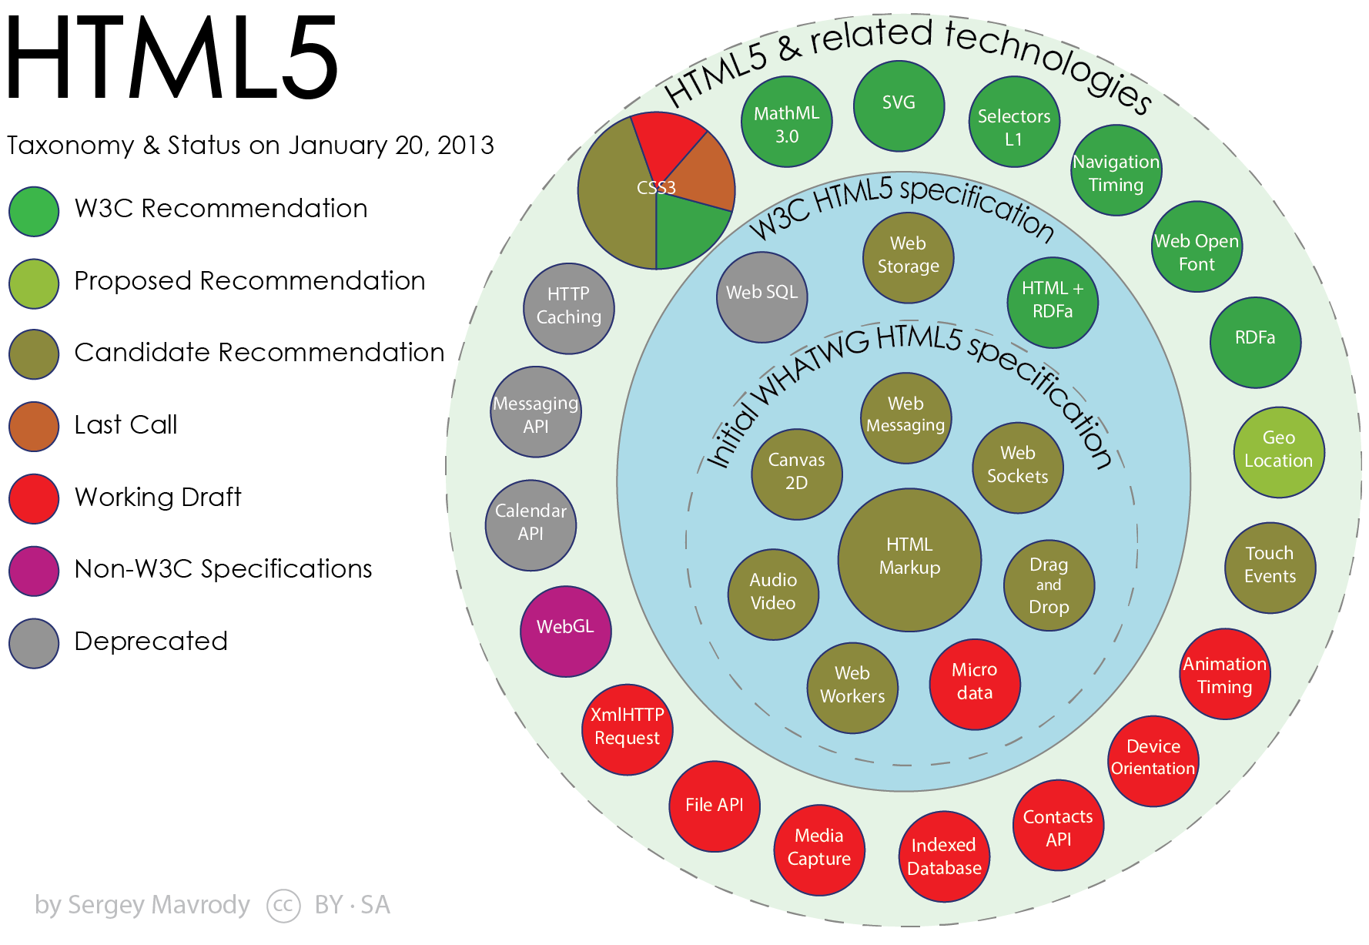
Notes:
This is a diagram of all the potential features that make up HTML 5. It will have a lot of cool capabilities.
The catch is that HTML 5 is still not a complete, finalized standard. Some of these features are implemented, others are not. Some will even be abandoned.
This list shows the order of completion, where W3C Recommendation is a completed standard, down to working draft that is still being developed and changed – Including a few features that have been thrown out or deprecated for a variety of reasons.
I will demo Canvas and Drag & Drop here – but I don’t have time to demo all of these, but you can see some are very interesting.
Audio/Video is there.
Web Messaging and Web Sockets bring some advanced networking capabilities to the web page (web apps that do chat or constantly need to refresh the page)
Web Storage – better than cookies. Web SQL looked very cool – from a database perspective. But they got rid of that.
Look at everything for mobile – geolocation, media capture, touch events, device orientation. This is very much on purpose.

Slide 3
Why HTML 5?
“New open standards created in the mobile era, such as HTML5, will win on mobile devices”
Steve Jobs
Notes:
We touched on some of these ideas about Why HTML 5 already but I want to re-iterate the benefits of it – especially on mobile devices.
HTML5 has been “out” for a while – but not the mobile aspects of it. I think that is where it will really shine in the long term.
If you haven’t read steve jobs “Thoughts on Flash” yet, it is a short but very good read – explaining much better than I can, the problem with Flash specifically on mobile devices and how HTML 5 is the way to go.
Open – flash is 100% proprietary. You have to rely 100% on adobe
“full web” – flash defends itself as being needed to experience the full web but more and more websites are moving away from it
Reliability, security, and performance – Jobs doesn’t want to reduce reliability and security of iPhones by adding flash. Symantec highlights flash as having one of the worst security records.
Some issues just for mobile:
It drains battery life a lot
Has no Touch
There are development issues making flash apps and they are inconsistent with the standard development process
HTML 5 addresses all these problems and steve jobs fully endorsed it as the solution to replace flash.
Microsoft with Metro and Windows 8 lets you now create full metro apps in just HTML5/Javascript.
This is where HTML 5 is headed and since most of us are CIS or IS educators, I think this where the classroom should be headed also.
Mobile development mixed with HTML 5 and JavaScript as part of a curriculum. I think that is coming and we need students to be able to make cool mobile apps and web apps using these technologies.
I will demo a few simple examples at the end of what students can build using HTML 5 that is quick and easy.

Slide 4
User Agent / Client Support
Not all HTML5 features are fully (or consistently) supported across the browsers
Can I use…
Compatibility tables for support of HTML5, CSS3, SVG and more in desktop and mobile browsers.
Tools to Check
http://html5readiness.com/
http://caniuse.com/
http://www.findmebyip.com/litmus/
http://mobilehtml5.org/
http://html5test.com/
http://html5please.us/

Slide 5
Web Browser Support Remedies
Google Chrome Frame
Advanced HTML features/HTML 5 for IE 8
HTML 5 Shim
An easier fix
Also known as HTML 5 Shiv
Used by many other APIs/Libraries

Slide 6
Obtaining Popular HTML5-Oriented JS and CSS Libraries
A Content Delivery Network
Google - https://developers.google.com/speed/libraries/devguide
Microsoft - http://www.asp.net/ajaxlibrary/cdn.ashx
We find that Cloudfare is very comprehensive:
http://cdnjs.com/

Slide 7





HTML 5 Examples
Notes:
Lots of websites already take advantage of html 5 and we use these sites and these bits of html 5 everyday and I bet your students do to.
Gmail
Offline, CSS3, Drag & Drop attachments
Dropbox
Drag & Drop files
Facebook
Drag & Drop pictures, videos, Multimedia
YouTube (HTML 5 Video Player in beta)
Multimedia

Slide 8
HTML 5 Supports Emerging Techniques
“Web 2.0”
An open-standards approach that does not rely on 3rd parties as much
AWS/RWS
Adaptive and responsive “Mobile First” website designs
SPA
Single-page architectures for site design
http://onepagelove.com/gallery/application

Slide 9
What can you do in the classroom?
Lots of demos you can give your students
Very easy in-class projects or homeworks
Some Demos We Have
Paint Demo
Drag & Drop Demo
Web Worker Demo
Geolocation Demo
A Few Demos We Didn’t Write:
http://html5demos.com/web-socket
http://html5demos.com/storage
http://html5demos.com/worker
Notes:
I’m going to demo two things that I wrote in HTML5 that are probably more in line with what you can do in the classroom or your students can do.
There is a whole host of demos you can do with html5. I chose canvas and drag drop, but as you saw there are many technologies that you bring together. These can be given as in class assignments – so 30 minutes or 45 minutes to complete or as homeworks. And the students can make something that works and works in the same way as gmail drag & drop or dropbox drag & drop or a web game like draw something. They can see how what they are doing is actually implemented and very popular in reality.

Slide 10
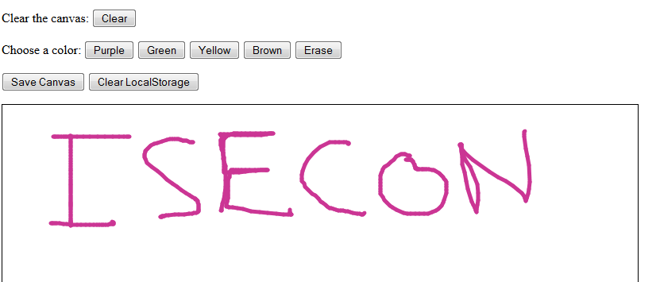
Paint Demo
https://github.com/wtamu-cisresearch/isecon
Download paint.html
Open in your favorite editor
Let’s implement more colors
Canvas Property: context.StrokeStyle = color
Notes:
So I wrote a Paint program purely in html canvas just using the canvas features of HTML 5.
Here are a few of the API calls that HTML5 canvas provides. These are accessed through javascript. Infact these are all that I needed, I didn’t even need the text ones. But CANVAS offers more API functions.
You can do a lot with just these few. Let me show you the demo I wrote very quickly and its about 60 lines of code – a lot of that is tracking the mouse and maintaining state – not the HTML5.
The great thing about this demo is that you can go as simple or complex as you want. You can add so many features to make it be a complete replacement to the desktop paint program. Do you want a paint bucket? Different line widths (lineWidth) etc….

Slide 11
Paint Demo
Implement Clearing the Canvas
Canvas Method: context.clearRect()
Use localStorage to save our image.
localStorage is a set of key/value pairs
Can only store strings
Limited to 10MB

Slide 12
Drag & Drop Demo
Download dragdrop.html
Drag & Drop lets you drag and drop any HTML element around your web page.
New HTML 5 properties/methods:
draggable, ondragstart(), ondragover(), ondrop()
Combine with HTML 5 File API to upload files from desktop.

Slide 13
More Cool Examples
21 Ridiculously Impressive HTML5 Canvas Experiments
http://net.tutsplus.com/articles/web-roundups/21-ridiculously-impressive-html5-canvas-experiments/
Data Visualization with D3.js
http://d3js.org/
CIS Students can do these
Professors from other disciplines
No longer need advanced CS degree or many years of programming experience.
Notes:
I’m going to put these slides online so that you can browse some of these links and examples. I found one site that lists 21 very impressive demos of html 5 canvas and what you can do with the canvas api.
CIS Students can implement a lot of these. I have one demo from this list that I saved offline and will show you. It’s called the cloth experiment.
I really like it because it is an example of how HTML5 can help other disciplines. Imagine a physics professor doing this simulation for his class or a bouncing ball simulation or kinematics. This will help in education. I worked on an HTML 5 WordCloud application that we infact presented earlier this conference and part of our goal with that was to show that humanities or other non-technical disciplines can take advantage of some of these technologies.
HTML5 and CIS can help other disciplines answer some of their questions by using our tools.
To do simulations like this in the past, you needed many years of serious programming experience – especially to do the graphics. HTML5 makes it much easier and quicker.
That cloth experiment was very impressive and infact is not too difficult but requires a lot of math for the physics – which helps with the interdisciplinary aspect. I think a technical physics professor could make something like that cloth experiment without delving into too much computer science. She would just need to know the physics and the math.

